Slide 1






and

Slide 2
Presented By
1) SHARISHMA LALAM
2) FATIMA SANI
3) SHWETHA SHINDE
4) JAHNAVI CHOWDARY
5) GEETHA PRIYANKA

Slide 3
The Problem Statement :
'Study & Play', a school, has different branches spread across all parts of India. Students of ‘Study & Play’ school, have appeared for the 10th & 12th board exams, and their results have been recently published. They have all done well.
' Study & Play' wants to recognize the teachers of all the subjects that were covered in the 10th and 12th board exams, for their students’ performance and award them accordingly.
To get that insight, ' Study & Play' wants to create a Data Warehouse solution on which they can do data analytics.

Slide 4
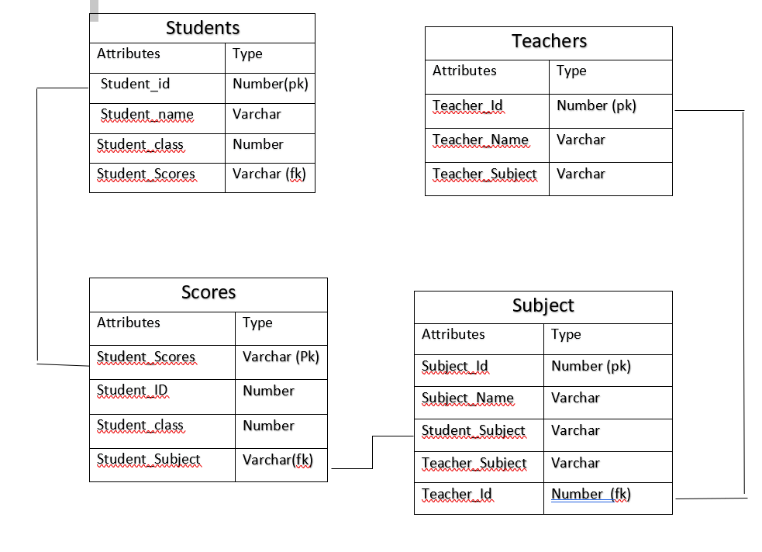
e
ER DIAGRAM:

Slide 5
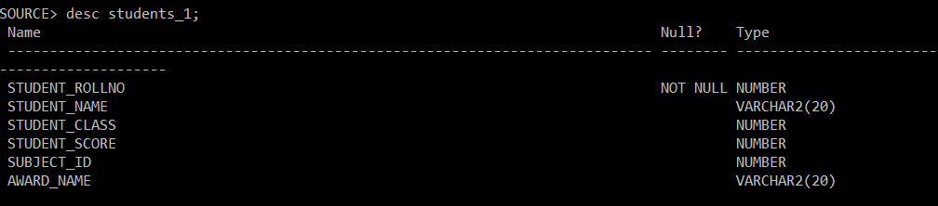
STUDENT TABLE:
Create Table Students_1(Student_Rollno number Primary Key, Student_name Varchar(20), Student_class number, Student_score number, Subject_ID number Award_name Varchar(20));

Slide 6
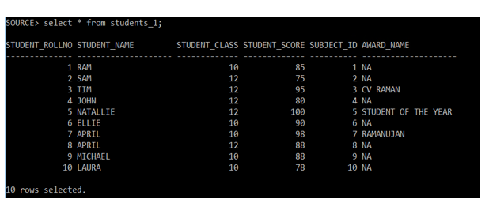
OUTPUT DATA OF STUDENT TABLE

Slide 7
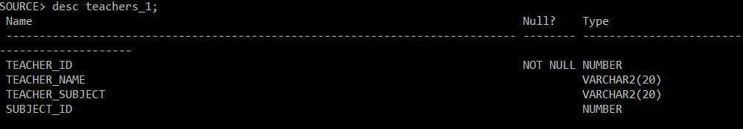
TEACHERS TABLE:
Create Table Teachers_1(Teacher_ID number Primary Key, Teacher_name Varchar(20), Teacher_subject varchar(20), Subject_ID number ));

Slide 8
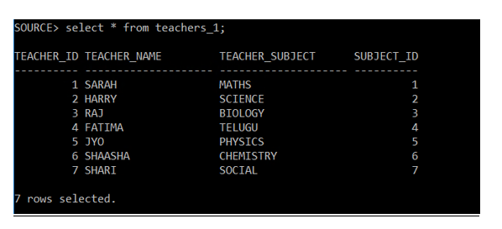
OUTPUT DATA OF TEACHER TABLE

Slide 9
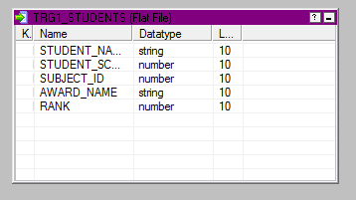
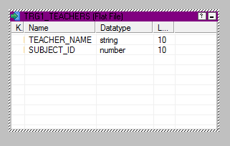
TRG1_STUDENTS TABLE: (FLATFILE)
TRG1_TEACHERS FLATFILE:

Slide 10
MAPPING CASE : M_MAPP_STUDY_AND_PLAY
TEST CASE:
Test case purpose:
Validate Mapping m_mapp_STUDY_AND_PLAY
Validate Task s_m_mapp_STUDY_AND_PLAY
Validate Workflow wf_s_m_mapp_STUDY_AND_PLAY
Test Procedure:
Go to Mappings
Select option debugger
Start debugger > Next > Use an existing session instance >
Next > Select session > Next > Target table option > Finish.
Next in instances.

Slide 11
Input Value/Test Data:
Sources: STUDENTS_1, TEACHERS_1
Target: TRG1_STUDENTS, TRG2_TEACHERS
Transformation:
Joiner: A join condition is used to join fields between the two sources.
Filter: A Filter transformation filters data out of the data flow based on a specified filter.
Ranker: A Rank transformation selects the Top or the Bottom range of the data.

Slide 12
Expected Result:
Check Mapping => Mapping is validated.
Go to Workflow => Message in workflow manager status bar: “Workflow
wf_s_m_mapp_STUDY_AND_PLAY is valid”.
Actual Result:
Message in workflow manager status bar: “Workflow wf_s_m_mapp_STUDY_AND_PLAY is valid”.
Remarks: PASS
Tester Comments:
The Data is retrieved from two sources tables i.e., STUDENTS_1 and TEACHERS_1 are joined together to calculate the data.
It is useful to give ranks according to the scores.

Slide 13
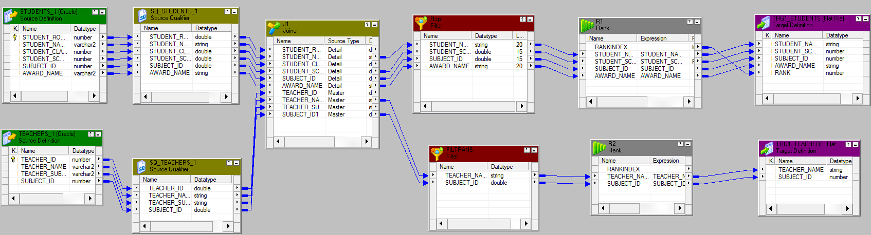
INFORMATICA ETL MAPPING

Slide 14
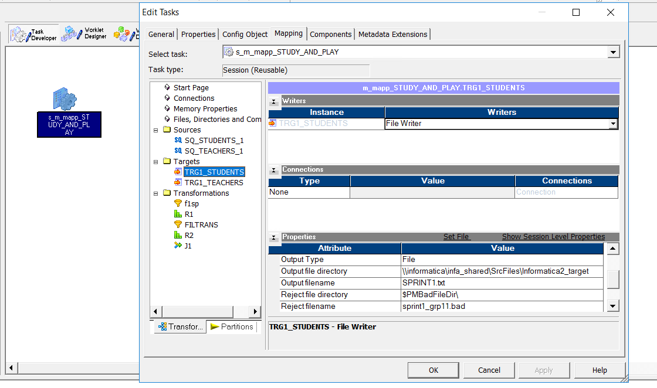

Slide 15
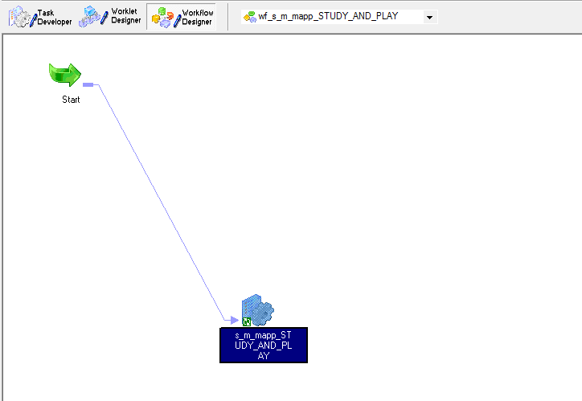
Workflow: VALID

Slide 16
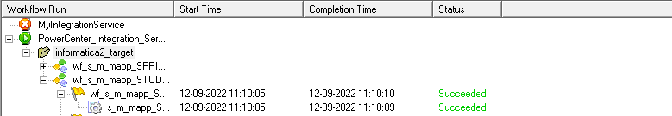
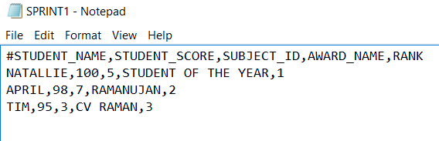
TEST VIEW

Slide 17
UNIT TESTING:
Test Case Purpose: validate workflow – wf_s_m_mapp_STUDY_AND_PLAY
Test Procedure:
> Go to workflow manager
> Open workflow
> Workflow menu-> click on validate
Input Value/Test Data : Sources ana Targets are available and connected
Sources : STUDENTS_1,TEACHER_1
Mappings : M_MAPP_STUDY_AND_PLAY
Targets : TRG1_STUDENTS,TRG2_TEACHERS(FLAT FILE)
Session : S_M_MAPP_STUDY_AND_PLAY
Transformations :
1) Joiner
2) Filter
3) Rank

Slide 18
Transformations in STUDENTS_1 :
Joiner : Joiner transformation is used to join both the SQ_STUDENTS_1 source qualifier and SQ_TEACHERS_1 source qualifier . And from joiner we mapped to the next transformation.
Filter1: Filter1 transformation is used to filter the STUDENTS_SCORE>=95 accordingly from the rows.
Rank1 : RANK1 transformation is used to rank the students with (STUDENTS_SCORE) number of ranks mentioned in the transformation attributes properties.
Transformations in TEACHERS_1 :
Joiner : Joiner transformation is used to join both the SQ_STUDENTS_1 source qualifier and SQ_TEACHERS_1 source qualifier . And from joiner we mapped to the next transformation.
Filter2: Filter2 transformation is used to filter the TEACHERS_NAME with SUBJECT_ID accordingly from the rows.
Rank2 : RANK2 transformation is used to rank the teachers with (TEACHERS_NAME) where number of ranks=3.

Slide 19
Expected Results: Message in workflow manager status bar: “Workflow WF_S_M_MAPP_ STUDY_AND_PLAY is valid “
Actual Results: Message in workflow manager status bar: “Workflow WF_S_M_MAPP_ STUDY_AND_PLAY is valid “
Remarks: Pass
Tester Comments:
Imported the data from source tables STUDENTS_1 , TEACHERS_1 and joined it with 2 categories of students and teachers using filter and rank transformations.
The output is useful to identify the number of students received the awards and their scores with ranks in an order.

Slide 20
INTEGRATION TESTING:
Test Case Purpose: Validate Mapping –M_MAPP_STUDY_AND_PLAY , validate workflow – wf_s_m_mapp_STUDY_AND_PLAY
Input Value/Test Data : Sources ana Targets are available and connected
Sources : STUDENTS_1,TEACHER_1
Targets :TRG1_STUDENTS,TRG1_TEACHERS
Transformations :
Joiner : We used joiner to join both the source tables and with a condition of STUDENTS_ID1=STUDENTS_1
Filter : Filter Transformation is used to filter the scores of the students with the condition of STUDENTS_SCORE>=95 to award the top 3 rankers and to filter the teachers according with the subject IDs.
3)Rank: RANK Transformation is used to rank the students accordingly with the students scores.

Slide 21
Expected Result:
Check Mapping> Mapping is validate
Go to workflow > Message in workflow manager status bar: “Workflow WF_S_M_MAPP_STUDY_AND_PLAY is valid”
Actual Result:
Message in workflow manager status bar : ”Workflow WF_S_M_MAPP_STUDY_AND_PLAY is valid”
Remarks : Pass
Tester comments:
Retrieved the data from source table STUDENTS_1, TEACHERS_1 and grouped it in 2 categories using transformations. The output is useful to identify the students ranks , awards according to the scores and teacher’s names according to the subject IDs.

Slide 22
REGRESSION TESTING:
Test Case Purpose: Validate Mapping –M_MAPP_SPRINT1_GRP1 validate workflow – wf_s_m_mapp_STUDY_AND_PLAY
Input Value/Test Data : Sources ana Targets are available and connected
Sources : STUDENTS_1,TEACHER_1
Targets : TRG1_STUDENTS,TRG1_TEACHERS
Transformations :
1) Joiner
2) Filter
3) Rank

Slide 23
Expected Result:
Check Mapping => Mapping is validated.
Go to Workflow => Message in workflow manager status bar: “Workflow
wf_s_m_mapp_STUDY_AND_PLAY is valid”.
Actual Result:
Message in workflow manager status bar: “Workflow wf_s_m_mapp_STUDY_AND_PLAY is valid”.
Remarks:
Pass
Tester Comments:
The Data is retrieved from two sources tables i.e., STUDENTS_1 and TEACHERS_1 are joined together to calculate the data.
It is useful to give ranks according to the scores.

Slide 24


THANK YOU

